Slide 1
CUSTOMER CHURN PREDICTION & PREVENTION
- By Pooja Tyagi
-By

Slide 2
DOMAIN..
Machine learning
Supervised Machine learning
Classification
Regression
Unsupervised Machine learning
Clustering
Natural Language Processing
Deep Learning
Big Data
MAJOR MODULES IN ARTIFICIAL INTELLIGENCE
RN
Reinforcement Learning

Slide 3
WHY CHURN ANALYSIS?
Churn Analysis
Evaluation of company’s customer loss rate so as to reduce it
Acquisition v/s Retention
Both are important factors and have direct impact on the profitability of the organization
Customer acquisition viewed as detrimental for company’s growth
Business Profitability
80% of the company profits may come from just 20% of existing customers.
Also, attracting new customers is 5 times more expensive than to keep an existing one
Customer Retention viewed as key factor for long-term success of company includes customer satisfaction, quality of service and loyalty programmes.

Slide 4


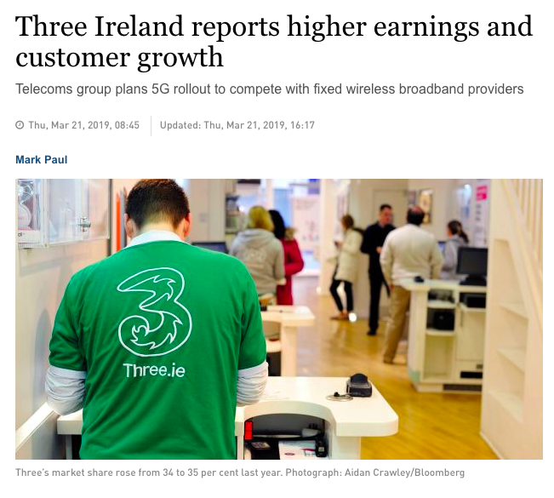
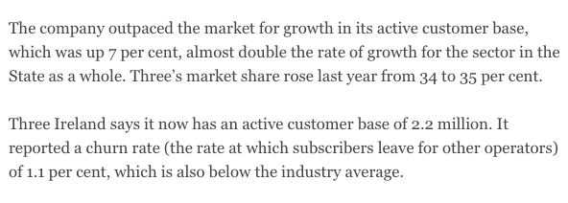
TELECOMMUNICATION SECTOR
Telecommunication Industry..
Why Churn Analysis is important for THREE IRELAND?

Slide 5
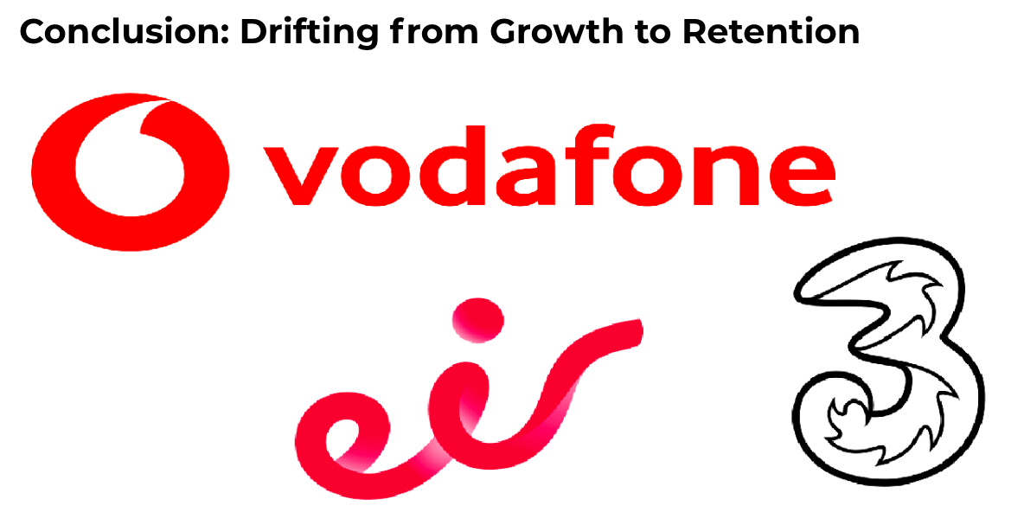
High competition
(e.g., GoMo)
Low Tariff Rates
Acquisition is Acquiring new customer is more expensive

Slide 6
PROJECT CYCLE AND INSIGHTS..
PROJECT INSIGHTS
Data Preparation
Exploratory Data Analysis and Feature Engineering
Data Visualization
Classification
Predictive Analytics
Results and Conclusion
Data set used, “Telco customer churn” , published by IBM
WORKFLOW:
Getting insights from data
Feature Engineering (helped in increasing the accuracy of the model)
Built Classification models (Logistic Regression, Random Forests, XGBoost)
Comparison and Evaluation of all the Models
Defining the policies to prevent the customers getting churn

Slide 7
DESIGN & IMPLEMENTATION
MODELS
Logistic Regression
PERFORMANCE METRICS
Accuracy
Random Forests
XGBoost
Confusion Matrix
AUC

Slide 8
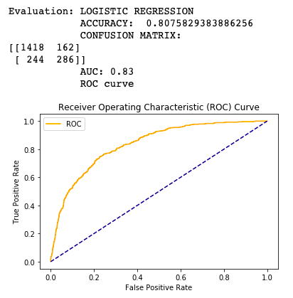
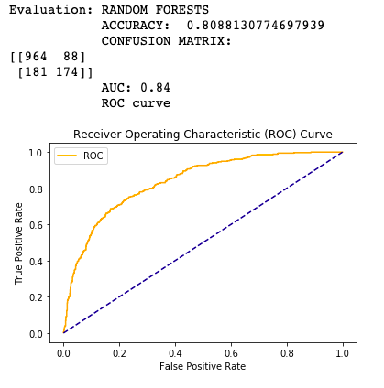
LOGISTIC REGRESSION | RANDOM FORESTS

Slide 9
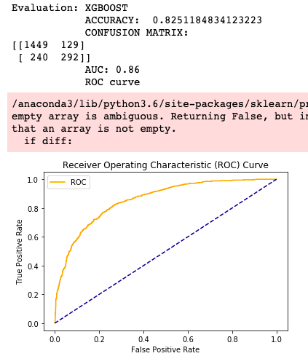
EXTREME GRADIENT BOOSTING | CONCLUSION
Extreme Gradient Boosting algorithm outperforms in solving this problem with an accuracy of 82.51% because,
XGBoost builds one tree at a time
Each tree helps to correct errors made by previous tree
In this Dataset, there were categorical variables with different number of levels, Random Forests in this case favors attributes with more levels.
In this problem, there were group of correlated features of similar relevance for the output, Random Forests favors smaller groups over larger groups

Slide 10
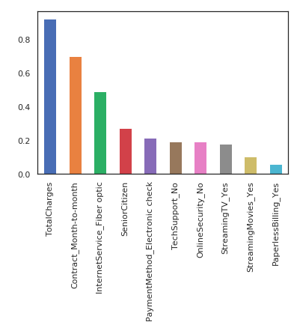
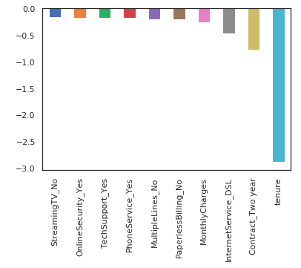
PREVENTION
Observations:
Two_year contract reduces chances of
Churn.
Two_year contract along with tenure have
most negative relation with churn as predicted
by XGBoost.
DSL internet service is also negatively
correlated.
Lastly, total charges, monthly contracts,
fiber optics can lead to higher churn.
Monthly contracts, TotalCharges and tenure
are the most important predictor variables to
predict churn.
NOTE: Interestingly Fiber Optics services are
faster but customers are likely to churn
because of it.

Slide 11
LEARNING..
Technical Learning
Getting insights from data
In depth knowledge of classification models
Business Learning
Telecommunication Market knowledge (products, strategy, future scope)
Strategizing results obtained from this project to real-time business
Learned different Performance metrics
Researched about Retention programmes started by Three (3Plus), Vodafone (Fantastic Days), Eir (Eir sports) etc.

Slide 12
FUTURE SCOPE
What more can be done in future..
Dataset – Including features that portrays customer usage details such as, calling mins (nationally, internationally), Data usage, text usage etc. will help in predicting churn.
Implementing Artificial Neural Networks will improve the prediction as suggested in research paper, “Customer churn prediction by hybrid neural networks”, by Chih-Fong Tsai. In this paper, author used hybrid neural network models to predict churn.
Hence, we can experiment more with Deep Neural Networks for churn prediction.

Slide 13

THANK YOU..

